Slide 1

Streaming Cross-sectional Visualization
with
Tim Bess / Tim Paine
Notes:
Thanks for coming, my name’s Tim and I work at a company called Prospective where we’re building the next generation of browser based data analytics.

Slide 2
Talk Overview
Background and Motivation
Perspective – What it is, and what it does
Connecting Spark Streaming / Perspective
Introducing Prospective
Notes:
Today we’re gonna talk about high performance programming for the web.
I’ll be addressing why we made perspective and what it’s good at.
This talk isn’t a Spark tutorial, but we will be using Spark to stream data into Perspective.
Perspective is fully open source, Apache2 license, not open core

Slide 3
Background and Motivation
Notes:
So the background is…

Slide 4









Background – Ecosystem
Web frameworks and data visualization tools abound!
Notes:
There are a ton of web frameworks and data visualization components out there, these are just a small set of examples.

Slide 5
Despite the abundance...
...somethings are still...
clunky
Notes:
Not to speak ill of any library in particular, but even when using some more advanced tooling you can end up with a bad user experience.
Advanced tooling, meaning user exploration and configuration.

Slide 6
Three Major Pain points
Virtualization
“Dumb grids”
Streaming
Many tables require pagination
Pagination not always convenient or suitable
Grids are often insufficient on their own
Sorting / Filtering / Pivoting
Other chart types
Static data sources / Streaming data sources / both
Many clients – snapshot + update?
6
Notes:
At a high level there are three major pain points. Virtualization, what we call “Dumb grids”, and Streaming.
3. Streaming
1. Streaming is less common and usually a distinct user experience from the static charing.

Slide 7

Pain Point 1: Virtualization

Slide 8
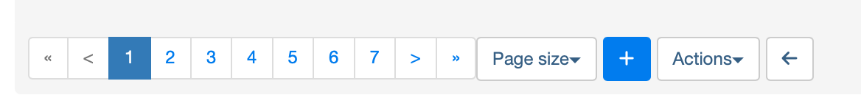
Pain Point 1: Virtualization
Virtual tables allow for “infinite scroll”, lazy loading
Absence of Virtualization leads to Pagination
Pagination is often ill-suited to the task, can be annoying
Most tools and frameworks do not support virtualization!
Notes:
Virtualization
* Pagination can be a bad user experience when you’re trying to quickly sift through some data.
* Virtualized tables with sorting means that you can quickly scroll to the part you care about. Virtualization is not a silver bullet, needs other tools like sorting, filtering, aggregation to make sense of huge datasets, but very useful for “medium” data
Pagination doesn’t really make sense with streaming/ticking/real-time data.
A lot of frameworks can’t or don’t support fetching a range of data and just don’t support that.
Screenshot from Airflow

Slide 9

Pain Point 2: “Dumb Grids”
Notes:
There are tons of datagrids out there, many of them are only really designed for really simple use cases.

Slide 10
Pain Point 2: ”Dumb Grids”

Slide 11
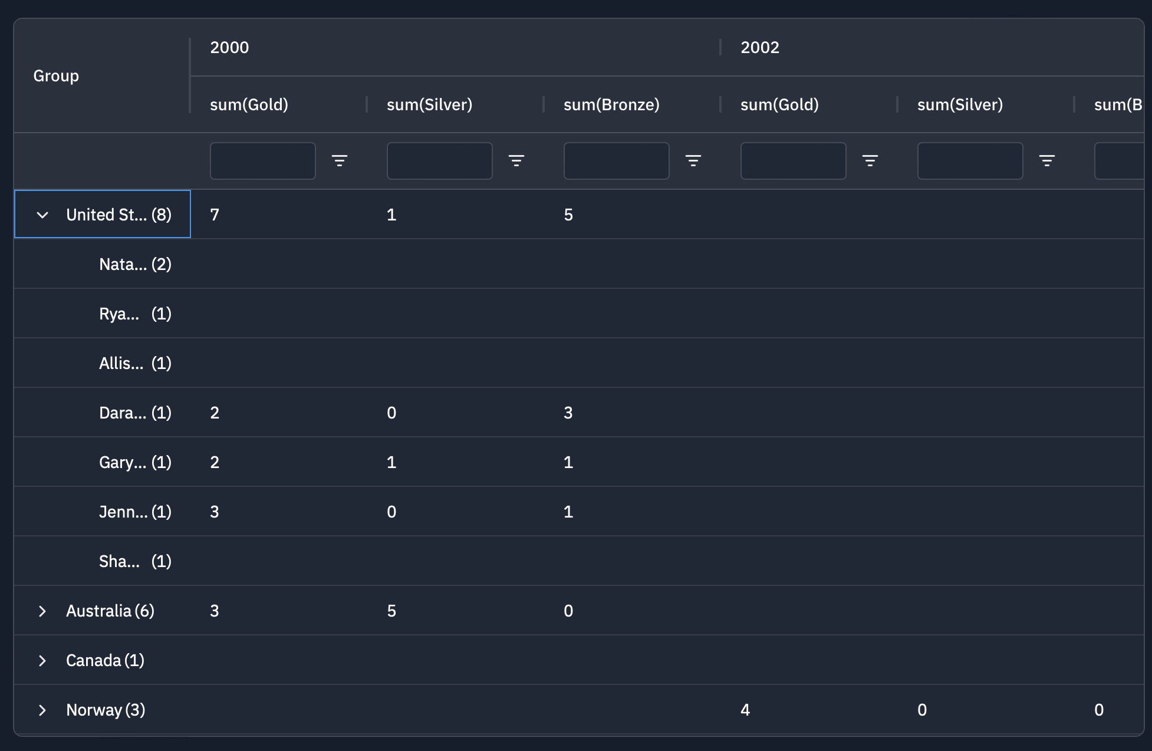
Pain Point 2: ”Dumb Grids”
Grids need to do more
Grids need to support basic features:
Sort
Filter
But also some advanced features
Row Pivots
Column Pivots
Aggregation Customization
Computed Columns
Spark Charts
This is tricky to get right, both visually and in terms of the user experience
11
Notes:
Many of them only have very basic sorting/filtering capability out of the box.
They may support spark charts, and _may_ support pivoting, but that’s definitely not a given.
Often what you end up with is this sparse grid with a lot of space taken up in a not so useful way. Also taking this and using the same pivots/columns to make a chart is not something that you get for free.
Less out-of-the-box functionality with regards to the data engine, and a large API surface is required to implement all of the UX features, e.g. for filters or aggregates.

Slide 12
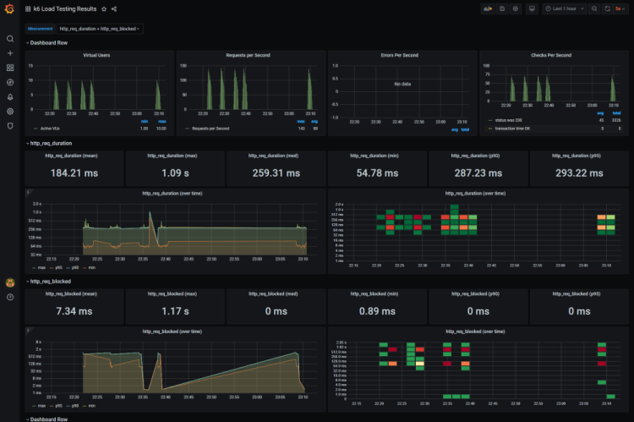
Pain Point 2: ”Dumb Grids”
The problem with “dumb grids”
Grids also should become more than grids
When you have to configure everything on behalf of your user, it leads to unuseable “vanity” dashboards
“Visualization Explosion”
A good data visualization tool should allow for users to explore!
12
Notes:
This is the other thing you see a lot is this sort of cartesian explosion of all the ways you can visualize the data that some power user or developer pre-configures for everyone else to consume.
A pre-configured dashboard can’t tell you anything you don’t already know.
The problem with this is it’s really hard to do any exploratory analysis and can really only show you things you already know you’re looking for.

Slide 13

Pain Point 3: Streaming
Notes:
The final pain point is streaming.

Slide 14
Pain Point 3: Streaming
Streaming data is everywhere – build with it in mind
All of the previous problems also apply, and need to work, on streaming data
How do you manage N users, each with their own pivoted / sorted grid with custom computed columns?
Difficult to implement strategies –
Polling + Pagination?
Snapshot + Updates?
Notes:
If you need streaming updates, that adds its own complexity which is compounded by all the other issues like pagination and pivoting.
How do you manage each user having potentially many different views on top of a table with their own aggregations, state, computed columns, etc. all multiplexing over one web socket?
Then on top of that what happens when you have N users concurrently all subscribing to different views?

Slide 15
Sample FastAPI Stream Server
from fastapi import FastAPI, WebSocket, WebSocketDisconnect
from fastapi.responses import HTMLResponse
app = FastAPI()
Notes:
This is an example from FastAPI’s docs for making a web socket chat server.

Slide 16
Sample FastAPI Stream Server
html = """
<!DOCTYPE html>
<html>
<head>
<title>Chat</title>
</head>
<body>
<h1>WebSocket Chat</h1>
<h2>Your ID: <span id="ws-id"></span></h2>
<form action="" onsubmit="sendMessage(event)">
<input type="text" id="messageText" autocomplete="off"/>
<button>Send</button>
</form>
<ul id='messages'>
</ul>
...
Notes:
Here we’re setting up a basic form for sending messages over the web socket.

Slide 17
Sample FastAPI Stream Server
<script>
var client_id = Date.now()
document.querySelector("#ws-id").textContent = client_id;
var ws = new WebSocket(`ws://localhost:8000/ws/${client_id}`);
ws.onmessage = function(event) {
var messages = document.getElementById('messages')
var message = document.createElement('li')
var content = document.createTextNode(event.data)
message.appendChild(content)
messages.appendChild(message)
};
function sendMessage(event) {
var input = document.getElementById("messageText")
ws.send(input.value)
input.value = ''
event.preventDefault()
}
</script>
</body>
</html>
"""
Notes:
This creates the web socket and wires up the receiving end of the server side broadcast and the sending side from the form.

Slide 18
Sample FastAPI Stream Server
class ConnectionManager:
def __init__(self):
self.active_connections: list[WebSocket] = []
async def connect(self, websocket: WebSocket):
await websocket.accept()
self.active_connections.append(websocket)
def disconnect(self, websocket: WebSocket):
self.active_connections.remove(websocket)
async def send_personal_message(self, message: str, websocket: WebSocket):
await websocket.send_text(message)
async def broadcast(self, message: str):
for connection in self.active_connections:
await connection.send_text(message)
manager = ConnectionManager()
Notes:
This is a very simple connection manager that simple broadcasts every message it receives to every other connected client.

Slide 19
Sample FastAPI Stream Server
@app.get("/")
async def get():
return HTMLResponse(html)
@app.websocket("/ws/{client_id}")
async def websocket_endpoint(websocket: WebSocket, client_id: int):
await manager.connect(websocket)
try:
while True:
data = await websocket.receive_text()
await manager.send_personal_message(f"You wrote: {data}", websocket)
await manager.broadcast(f"Client #{client_id} says: {data}")
except WebSocketDisconnect:
manager.disconnect(websocket)
await manager.broadcast(f"Client #{client_id} left the chat")
Notes:
And these are the routes needed.

Slide 20
That’s a lot! And it doesn’t do most of what we need...
Notes:
That’s a lot of code for a very simple chat room example and what we’re trying to do with visualizations is obviously a lot more complicated and rife with potential concurrency bugs.

Slide 21

What it is What it does

Slide 22


Interactive analytics and data visualization component, which is especially well-suited for large and/or streaming datasets
finos/perspective
Notes:
Interactive.
Embeddable component.
Good for large in memory data sets.
Good for streaming and static data sets as well.
Allows for the user to explore the data and slice/dice it however they like.

Slide 23
Perspective
Key Facts and Features
Implementation
Frontend
Features
C++ Engine
Symmetric compilation on frontend (WebAssembly) and backend (Python)
Client-only and Client/Server Architectures
Rust/TS/JS Based UI Plugin System
Web Components for ease-of-use
JSON-based configuration, data and configuration are separate
UI Plugins – Grid, Scatter, Bars, Lines, Maps, and more
Fast virtualization with view windows
Streaming sync via Apache Arrow diffs
Client/Server messaging protocol allows for alternative backends
Exprtk-based expression engine for computed columns
23
Notes:
C++ engine is the exact same engine, same API, same behavior, same performance, in JS, Python, Rust, C++
Multiple architectures is about flexibility
web components are not married to a JS framework
JSON config that separates data and configuration, enables exploration
Perspective's UI state is serializable, persistable, every user setting has a developer JSON config and vice versa.
Arrow data >>> with deltas <<<
ExprTK is safe to evaluate remotely

Slide 24
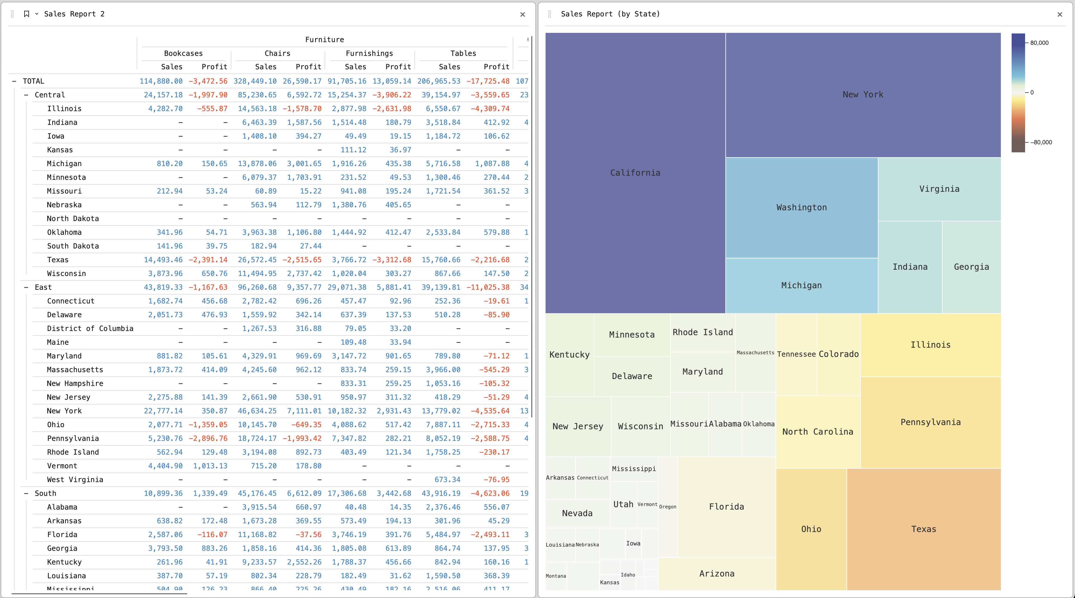
Perspective

Slide 25
Let’s run through the main features with an example dataset

Slide 26
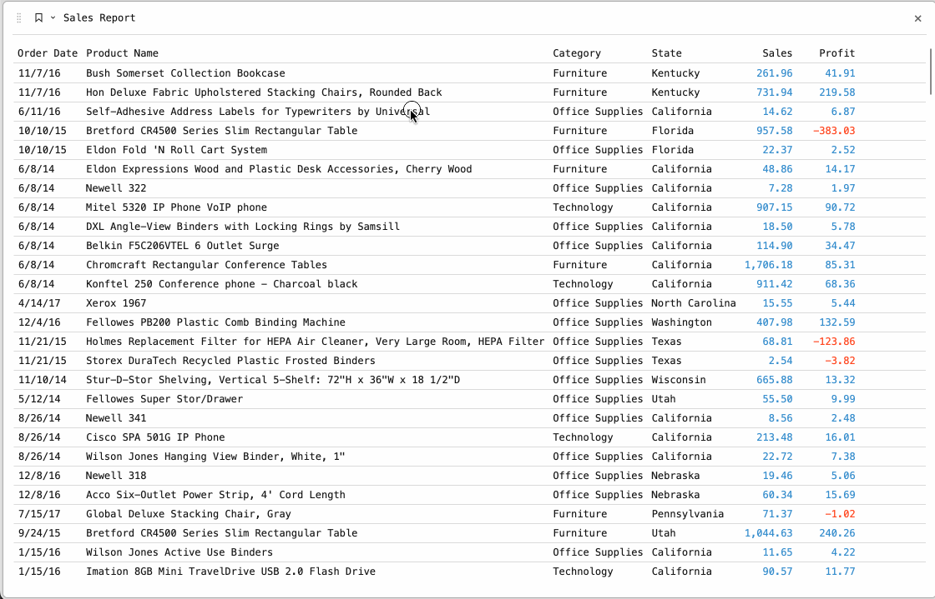
Sorting/Filtering/Pivoting

Slide 27
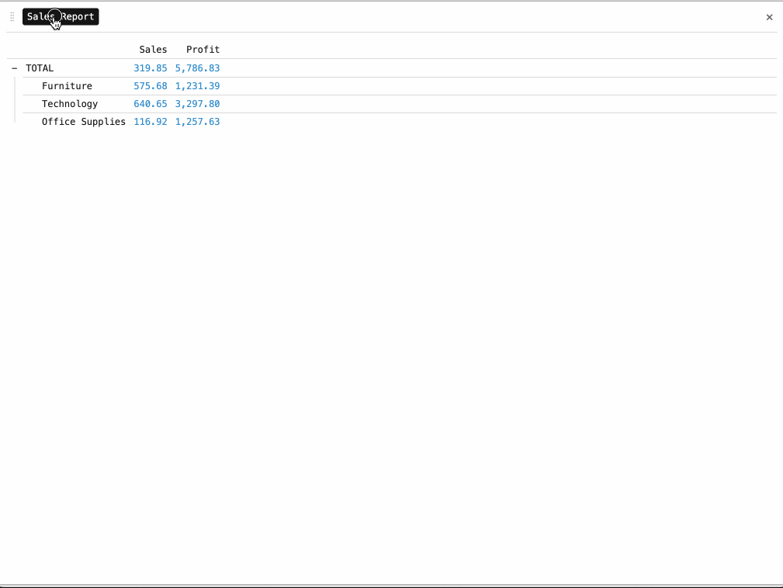
UI Plugins

Slide 28
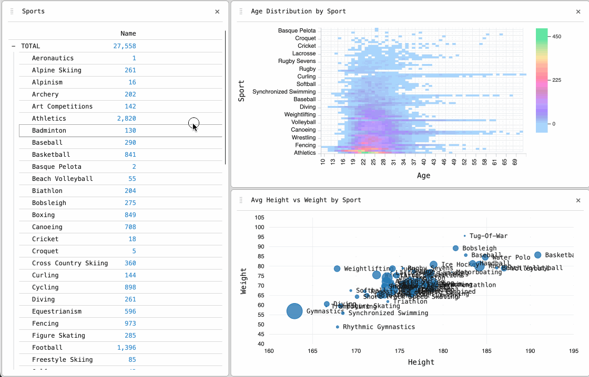
Fancy Stuff: Spark Bars / Crossfilter

Slide 29
Now let’s bring it all together with a full demo

Slide 30
Spark Streaming +

Slide 31
Spark Streaming + Perspective
An end-to-end example
Let’s build a simple but high-performance application
Dummy dataset – Machines, Utilization, and Jobs
Stream and aggregate data with Spark Streaming
Feed Data into Perspective / FastAPI Server

Slide 32
Demo time...

Slide 33

Demo Code:

Slide 34
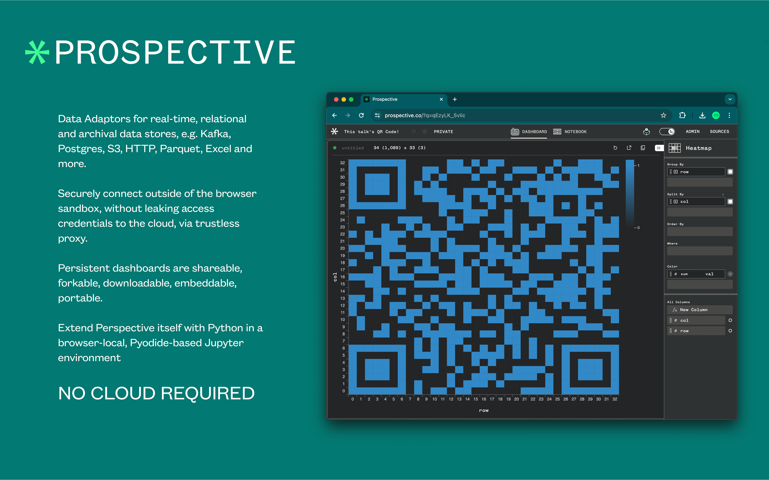
Notes:
… And all of this work was developed and Open-Sourced where I work, the Prospective Co, where we are developing the next generation of data visualization tech.
Link to slides and code here!

Slide 35

Q/A
Slides + Code ->

Slide 36
Streaming Cross-sectional Visualization
with
Tim Bess / Tim Paine

